Slide 1

PC Vision, Mission, & Consensus Building
Committee & Planning Council Business Meetings
Notes:
To ensure that the UNITED WE FIGHT. UNITED WE WIN. Artwork is on top of the photo you may have to click on photo box and select to SEND TO BACK.

Slide 2
Housekeeping
No smoking on HFUW property.
Visitors must be accompanied by HFUW staff in the building. Please take phone calls in the front lobby or outdoor areas.
Please only park in the designated parking spots/areas.
Location of restrooms.
Refreshments are on the side of the room.
Please mute cell phones.
If you would like to make a public comment, then a Public Comment Request Form must be filled out and given to PCS prior to the public comment section. Forms are located at the sign in table.

Slide 3

Vision Statement
A quality continuum of care for all individuals and families with, affected by, and at risk for HIV.

Slide 4

Mission Statement
To improve the quality of life for individuals with HIV by responding to their existing and emerging needs and to provide educational and behavioral strategies to reduce and prevent the spread of HIV.

Slide 5

Conflict of Interest
An actual or perceived interest in an action that will result or has the appearance of resulting in personal, organizational, or professional gain.
Please remember to state your conflicts before answering a question or making a statement for which a conflict might apply.

Slide 6

CFHPC Core Values
Empowerment
Commitment
Quality
Integrity

Slide 7
Group Agreement
Online, if you are not speaking or presenting, please keep your lines muted. (Be mindful of volume and background noise if online or on the phone).
Respect Pronouns. Don’t pressure others or feel pressured to disclose pronouns.
Make sure everyone has the opportunity to speak and voice opinions respectfully.
Freely and shamelessly ask questions.
Respect Florida Sunshine Law.
Don’t disclose anything that you would like to be kept confidential. Meeting audios are recorded, and documents and participation are open to the public.
Remember that everyone has different passions, experiences, barriers, and communication styles. Respect others always.
Be mindful of others’ learning styles and processing ability.

Slide 8
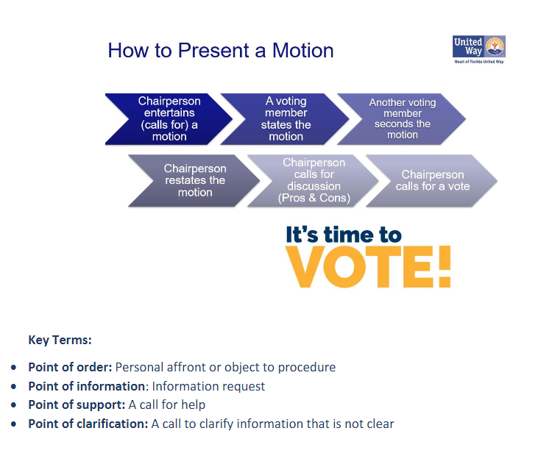

Slide 9
Making Sure Your Voice Is Heard! (Members of the Public)
Before/After Meetings
Email PCS a list of questions
Call Planning Council Support
During Meetings
Public Comment Section
Other Ways to be Heard
Participate in any open surveys
PCS Face to Face (before/after meetings)
Announcements at end of meetings

Slide 10

Public Comment Expectations
Make sure to fill out the form first- these are located at the sign-in table
Please wait to be called on by the Chairperson
3 minute maximum
Please remember that if you have a personal concern that needs to be resolved, then PCS will connect you with an appropriate representative in the room after the meeting.

Slide 11
Here's How the Council Can Become More Reflective of the HIV Epidemic...
Looking to recruit folks that are...
Ryan White HIV/AIDS Program (RWHAP) clients without conflicts (i.e., does not work for a RWHAP-funded organization)
Race: All
Gender: All
Age: 20-49 unconflicted/unaffiliated RWHAP clients
Mandated Seats: Representatives of/or Formerly Incarcerated People with HIV
Reminder: The Council is always looking for folks who want to see a change in their community and those with various backgrounds and experiences.

Slide 12



