Slide 1

PC Vision, Mission, & Consensus Building
Committee & Planning Council Business Meetings
Notes:
To ensure that the UNITED WE FIGHT. UNITED WE WIN. Artwork is on top of the photo you may have to click on photo box and select to SEND TO BACK.

Slide 2
Housekeeping
No smoking on the property.
Visitors must be accompanied by staff in the building, unless otherwise stated. Please take phone calls in the front lobby or outdoor areas.
Please only park in the designated parking spots/areas.
Location of restrooms.
Refreshments are on the side of the room.
Please mute cell phones.
If you would like to make a public comment, then a Public Comment Request Form must be filled out and given to PCS prior to the public comment section. Forms are located at the sign-in table.

Slide 3

Public Comment Expectations
Make sure to fill out the form first. Public Comment Forms & the rules governing public comments are located at the sign-in table.
Public comments should be related to items that pertain to the agenda that are within the Planning Council's authority to address and/or duties of the Planning Council.
Please wait to be called on by the Chairperson.
There is a 3-minute maximum for comments.
Please remember that if you have a personal concern (ex. an issue with an organization) that needs to be resolved, then PCS will connect you with an appropriate RWHAP Part A or Part B representative in the room after the meeting.
Use the announcement section at the end to inform the Planning Council of upcoming HIV or health-related events in the community.

Slide 4
Making Sure Your Voice Is Heard!
Before/After Meetings
Email PCS a list of questions
Call Planning Council Support
Public Comment Section
Other Ways to be Heard
Participate in any open surveys
Announcements at end of meetings
Set up an in person meeting
During Meetings

Slide 5

Mission Statement
To improve the quality of life for individuals with HIV by responding to their existing and emerging needs and to provide educational and behavioral strategies to reduce and prevent the spread of HIV.

Slide 6

Vision Statement
A quality continuum of care for all individuals and families with, affected by, and at risk for HIV.

Slide 7

CFHPC Core Values
Empowerment
Commitment
Quality
Integrity

Slide 8

Conflict of Interest
An actual or perceived interest in an action that will result or has the appearance of resulting in personal, organizational, or professional gain.
Please remember to state your conflicts before answering a question or making a statement for which a conflict might apply.

Slide 9
Group Agreement
Online, if you are not speaking or presenting, please keep your lines muted. (Be mindful of volume and background noise if online or on the phone).
Respect Pronouns. Don’t pressure others or feel pressured to disclose pronouns.
Make sure everyone has the opportunity to speak and voice opinions respectfully.
Freely and shamelessly ask questions.
Respect Florida Sunshine Law.
Don’t disclose anything that you would like to be kept confidential. Meeting audios are recorded, and documents and participation are open to the public.
Remember that everyone has different passions, experiences, barriers, and communication styles. Respect others always.
Be mindful of others’ learning styles and processing ability.

Slide 10
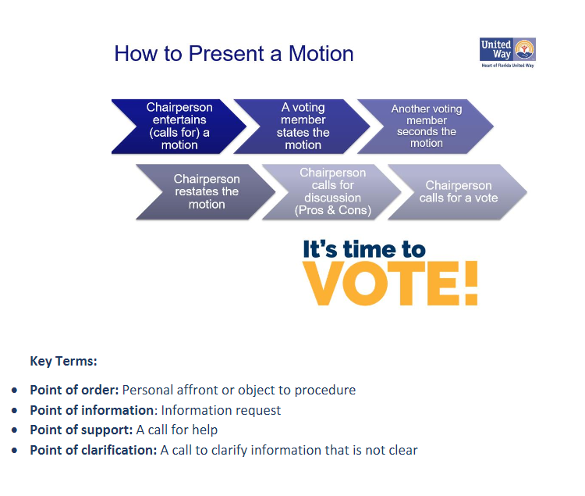

Slide 11
Here's How the Council Can Become More Reflective of the HIV Epidemic...
Looking to recruit folks that are...
Ryan White HIV/AIDS Program (RWHAP) clients without conflicts (i.e., does not work for a RWHAP-funded organization)
Race: All
Gender: All
Age: 20-49 unconflicted/unaffiliated RWHAP clients
Mandated Seats: Representatives of/or Formerly Incarcerated People with HIV and Hospital/Healthcare Planning Agencies
Reminder: The Council is always looking for folks who want to see a change in their community and those with various backgrounds and experiences.

Slide 12



