Slide 1

WAD Planning Meeting
Friday, September 11, 2026
Notes:
To ensure that the UNITED WE FIGHT. UNITED WE WIN. Artwork is on top of the photo you may have to click on photo box and select to SEND TO BACK.

Slide 2

Event Info
Date:
  Tuesday, December 1st, 2026
Time:
  Networking Hour: 5:30 pm - 6:30 pm
  Event Programming: 6:30 pm - 7:30 pm
Theme:
  45 Years Together: United and Unbreakable
Venue:
  Beardall Senior Center (Setup begins at 2:00 PM)
    800 South Delaney Avenue, Orlando, FL 32801

Slide 3
Decisions Needed for WAD Awards
Updates to award criteria?
Updates to selection process?
  How to make selection more fair
Number of winners
  1 winner per category, 3 winners total for OSA (same as last year)
  1 winner per category for EMA & Brevard (6 winners total to choose)
  Something else?

Slide 4
WAD Award Category: Unsung Hero Award
Unsung Heroes are those who exhibit extraordinary courage, commitment, and selflessness for the cause without seeking credit or praise for the incredible work that they do. They lift others up without expecting anything in return because of their fierce compassion and care for those living with or affected by HIV. A person who demonstrates resilience and perseverance in the face of stigma and hardship and acts as a beacon to the community.
Please note: the Unsung Hero Award recipient must not be employed by a Ryan White HIV/AIDS Program provider or HIV service provider and cannot have received the Unsung Hero Award in the past. If your nominee works for an HIV provider, then your submission will automatically be moved to the Service Award category.

Slide 5
WAD Award Category: Service Award
The annual Service Award is reserved for those in the HIV workforce who are unwavering in their dedication to improving the healthcare outcomes of the clients that they serve. They are committed to quality, equity and demonstrate integrity in the face of hardship.
Those who qualify for the Service Award include, but are not limited to, Case Managers, Peers, Early Intervention Specialists, senior leadership, Referral Specialists, mental health or substance use providers, and any other individual in the HIV field who stands out for their dedication and passion.
The Service Award recipient must not have received the Service Award in the past.

Slide 6
WAD Award Category: Lifetime Achievement Award
The Lifetime Achievement Award is given to those who have devoted their careers to ending the HIV epidemic through exemplary service, perseverance, and leadership.
Eligible nominees have made a significant impact in the lives of both clients and colleagues by being exemplary role models via contributions that improve the system of care for all, increase access and health equity, and reduce stigma.
Individuals eligible for this category must have at least fifteen (15) years of experience in HIV-related work and cannot have received the Lifetime Achievement Award in the past.

Slide 7
Volunteers needed
Set up crew – begins at 2:00 PM
Parking/outdoor guides (2-3 people)
Registration table (2 people)
Quilt Ceremony Handlers
Displayed quilt attendants (collaborating w/ QLatinx)
Photobooth assistant(s) – if needed
Break down crew
Others?

Slide 8
Info Recap + Venue pics

Slide 9
Networking Hour (5:30 pm - 6:30 pm)
Refreshments and small bites
  Vendor TBD
Playlist for music
Possible Displays/Activities:
  Featured quilts for individuals and organizations (QLatinx)
  HIV Photovoice Display (Dr. Joe)
  Projector with videos of previous WAD events (PCS?)
  Grass wall for guests to pin on messages related to event theme or a call to action (QLatinx & PCS)
    Theme: 45 Years Together: United and Unbreakable
  Photobooth (Carlitos – QLatinx; will require volunteers to assist)

Slide 10
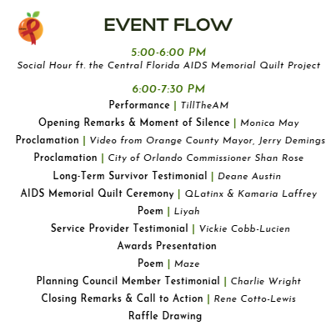
Event Programming (6:30 pm - 7:30 pm)
2025
30 mins shorter than 2025
Agreed programming items:
  Opening remarks & moment of silence
  City/county proclamations
  Quilt ceremony
  Presentation of awards
  Closing remarks
Keeping in mind: striking a balance between honoring those who have passed and are currently struggling with HIV and celebrating those who are living and thriving with HIV and those working towards ending the epidemic

Slide 11
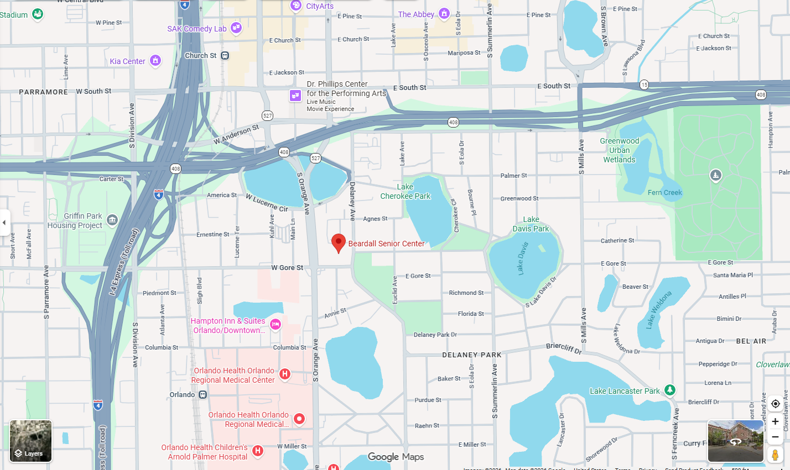
Beardall Senior Center

Slide 12
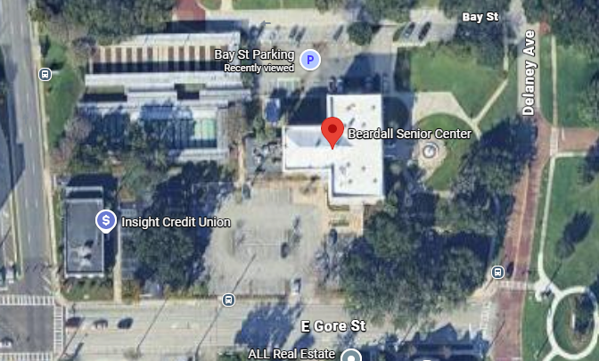
Beardall Senior Center

Slide 13
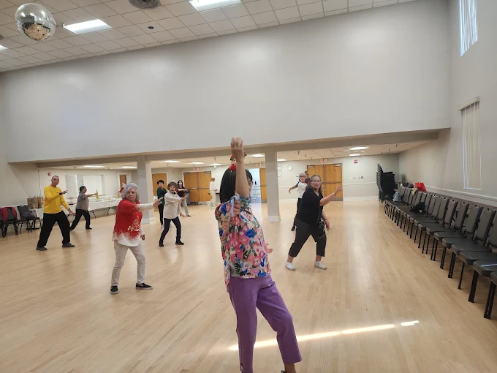

Slide 14
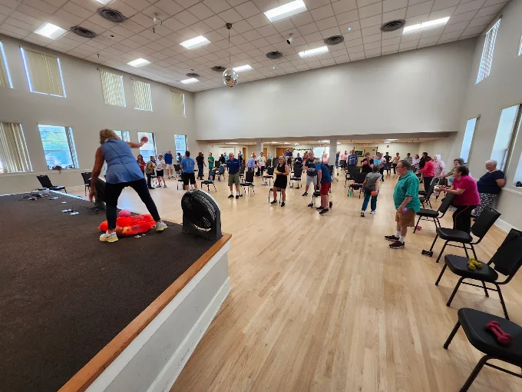

Slide 15
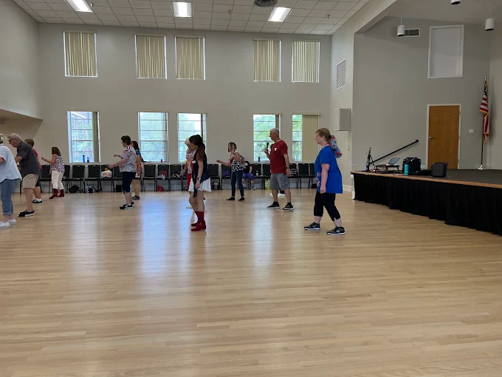

Slide 16
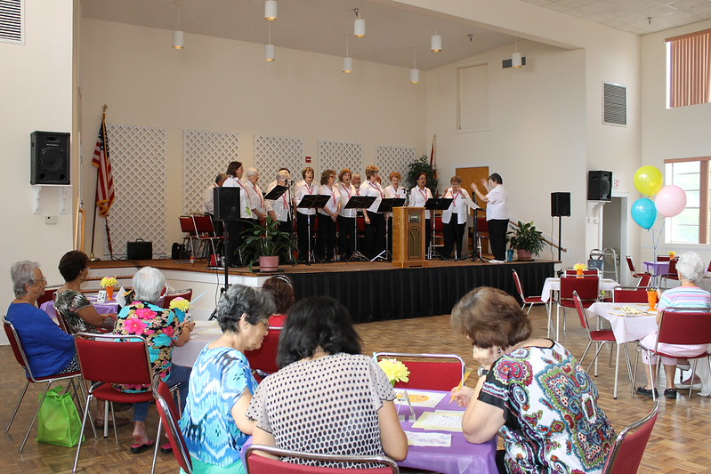

Slide 17
